Slide 1
Sentiment Analysis
CS 410-Text Information System
Liu, Ling-Hsi (lhliu2@illinois.edu)
Nishant Gulgulia (nishant9@illinois.edu)
Pradeep Khandelwal (pk5@illinois.edu)

Slide 2



Team Introduction
Liu, Ling-Hsi
Nishant Gulgulia
Pradeep Khandelwal

Slide 3
Project Overview
Sentiment analysis on political figure
Create Infrastructure (AWS Cloudformation)
Collect tweets from twitter (Twitter API)
Store and analyze tweets (AWS S3, AWS Lambda, AWS Athena)
Perform sentiment analysis (Amazon Comprehend)
Build dashboard (AWS QuickSight)

Slide 4
Goal
Understand about NLP (Natural Language Processing)
Understand about AWS architecture, setting (connect to different services), and AWS managed services, such as Athena, QuickSight, Amazon Comprehend
Build generic framework to analyze sentiment analysis
Understand features, functions and limitations of managed services like Amazon Comprehend
Build working model of sentiment analysis

Slide 5
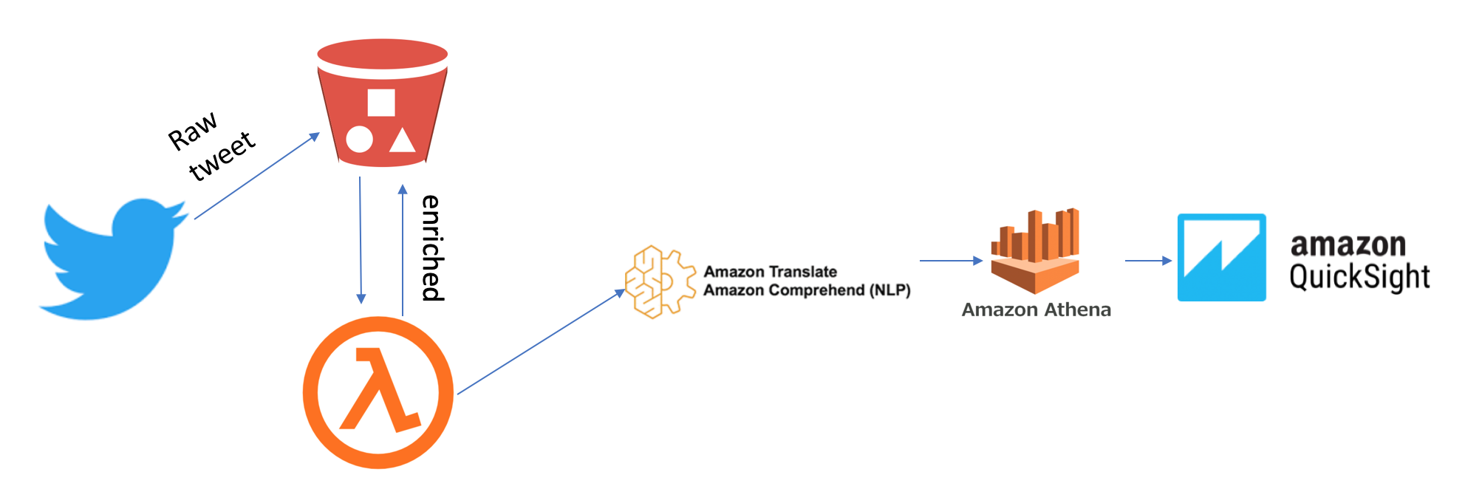
Architecture Diagram

Slide 6
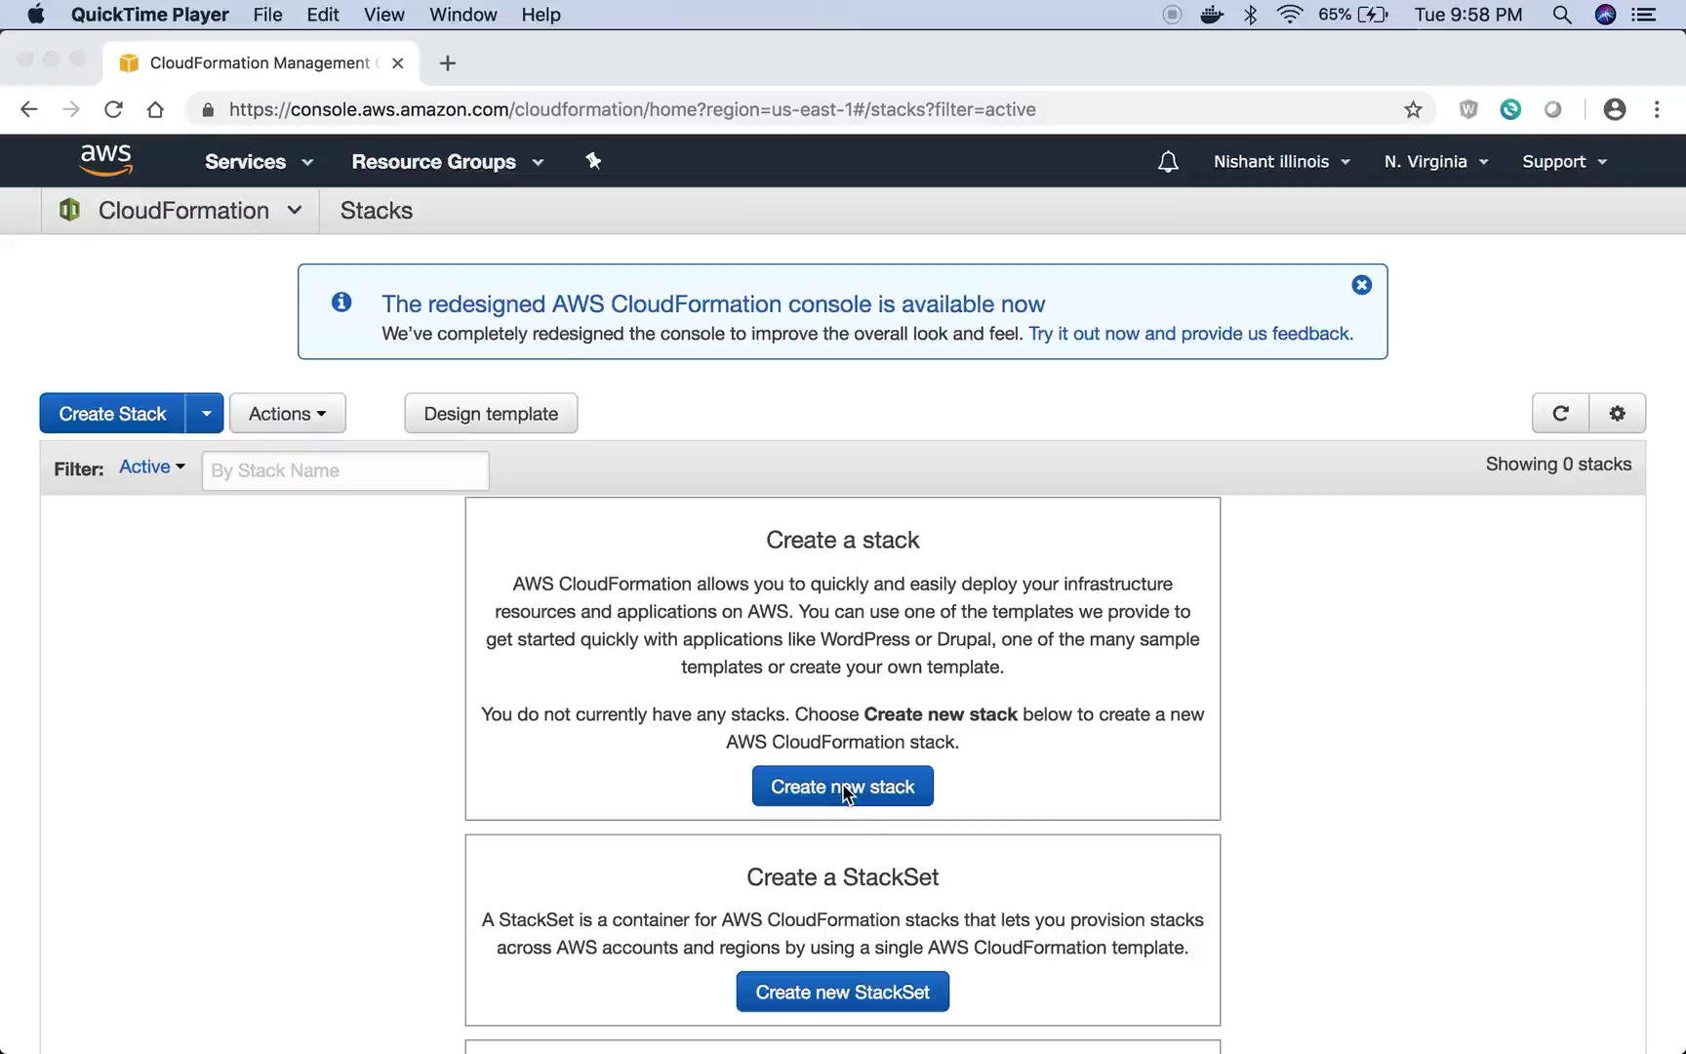
Demo

Slide 7
Future Enhancements
Explore other managed services with similar dataset
Build complete server-less infrastructure
Add amazon Kinesis and Glue to provide real time streaming and sentiment analysis
Containerize solution and add to fargate

